Slide 1
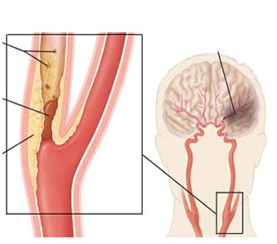
Revascularization in Carotid artery stenosis
Evidence review

Slide 2
Questions?
When and in whom do we have to consider revascularization for carotid stenosis?
What is the preferred mode of revascularization- CEA vs CAS?
  Limitations of available data
Role of new embolic protection devices during CAS
Specific situations
  Restenosis after carotid stenting
  Restenosis after carotid endarterectomy
  Carotid stenosis in patients requiring bypass surgery.
  CEA in the presence of contralateral occlusion.
Current Guidelines

Slide 3
INTRODUCTION
Stroke is the third leading cause of death worldwide after IHD and cancer.
ECVD (extracranial carotid and vertebral artery disease) as a cause for stroke difficult to determine from population studies.
  Northern Manhattan Stroke study- clinical stroke with infarct on brain imaging with > 60% occlusion of carotid/ vertebral artery by noninvasive imaging or angiography
Causes:
  Atherosclerosis- most common
  Fibromuscular dysplasia
  Cystic medial necrosis
  Arteritis
  Dissection
Approx 7% of first ischemic strokes were associated with ECVD.
White H, Boden-Albala B, Wang C, et al. Ischemic stroke subtype incidence among whites, blacks, and Hispanics: the Northern Manhattan Study. Circulation. 2005;111:1327–31

Slide 4
Carotid Stenosis
Management Strategies
MEDICAL THERAPY
CAROTID ENDARTERECTOMY (CEA)
CAROTID ANGIOPLASTY AND STENTING (CAS)
Notes:
Basic aim of treatment is to prevent new onset stroke/TIAs.
2 factors best associated with increased incidence of new onset stroke:
Presence of symptoms attributable to the carotid disease.
Degree of stenosis.

Slide 5
Evidence
TRIALS | SYMPTOMATIC | ASYMPTOMATIC
CEA vs OMT | NASCET (1998) ECST (2003) | ACAS (1995) ACST(Early CEA vs deferred CEA) (2004)
Registries of CAS
CEA vs CAS | CARESS SPACE(2008) EVA- 3S(2008) SAPPHIRE(2008) ICSS (2010) CREST(2010) | CARESS SAPPHIRE(2008) CREST(2010)

Slide 6
Landmark trials of CEA vs medical therapy
 | NASCET | ECST
TRIAL TYPE | RANDOMISED CONTROL, MULTI CENTRE | RANDOMISED CONTROL, MULTI CENTRE
SITE | US AND CANADA | EUROPE
INCLUSION CRITERIA | < 80 YEARS WITH TIA/ NON DISABLING STROKE WITHIN PREVIOUS 120 DAYS WITH CAROTID STENOSIS 30-99%. | ANY AGE WITH TIA/ NON DISABLING STROKE WITHIN 6 MONTHS WITH SOME DEGREE OF CAROTID STENOSIS
NO OF PATIENTS | 1415 | 3024
RANDOMIZATION | 50:50 | 60:40
CONCLUSION | CEA BENEFICIAL IN SYMPTOMATIC PATIENTS WITH > 50% STENOSIS | CEA BENEFICIAL IN SYMPTOMATIC PATIENTS WITH > 80% STENOSIS
NASCET: The North American Symptomatic Carotid Endarterectomy Trial
ACAS: Asymptomatic Carotid Atherosclerosis Study
ACST: Asymptomatic Carotid Surgery Trial
ECST : European Carotid Surgery trial
Notes:
The North American Symptomatic Carotid Endarterectomy Trial
The European carotid surgery trial

Slide 7
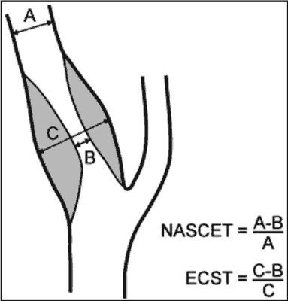
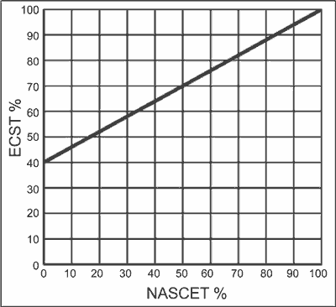
Different methods for assessing severity in carotid stenosis in NASCET and ECST.
Different definitions for stroke outcomes:
NASCET: event with symptoms lasting > 24 hrs, retinal infarcts were included.
ECST: event with symptoms lasting > 7 days, retinal infarcts not included.
Notes:
NASCET was established by angiographic calculation of ICA stenosis percentage using the following formula:
% ICA stenosis = (1 - [narrowest ICA diameter/diameter normal distal cervical ICA]) x 100
ECST was established by angiographic calculation of ICA stenosis percentage using the following formula:
% ICA stenosis = (1 - [diameter of the most stenotic part/estimated original diameter at the site of the stenosis]) x 100

Slide 8
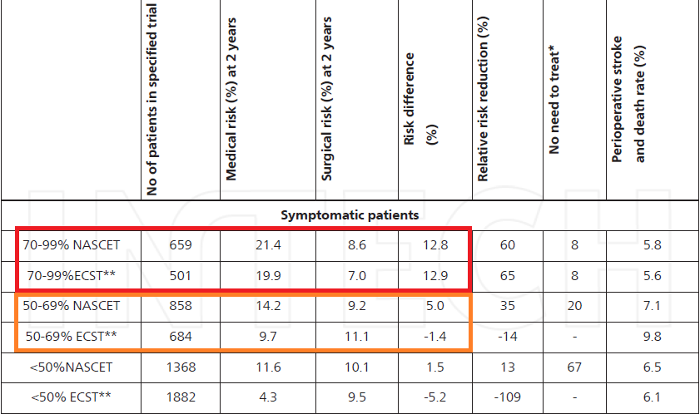
Meta analysis of ECST and NASCET: Surgery
Increased 5-year risk of ipsilateral ischemic stroke with <30% stenosis (absolute risk reduction –2.2%, P = 0.05)
No effect with 30-49% stenosis (absolute risk reduction of 3.2%, P = 0.6)
Marginal benefit with 50% to 69% stenosis (absolute risk reduction of 4.6%, P =0.04)
Highly beneficial with ≥70% stenosis without near-occlusion (absolute risk reduction of 16.0%, P < 0.001).
No benefit with near total occlusion (absolute risk reduction of –1.7%, P =0.9).

Slide 9
Notes:
NASCET: most episodes within the first year of an index event.
Emphasizes early surgical intervention following an index neurological event.

Slide 10
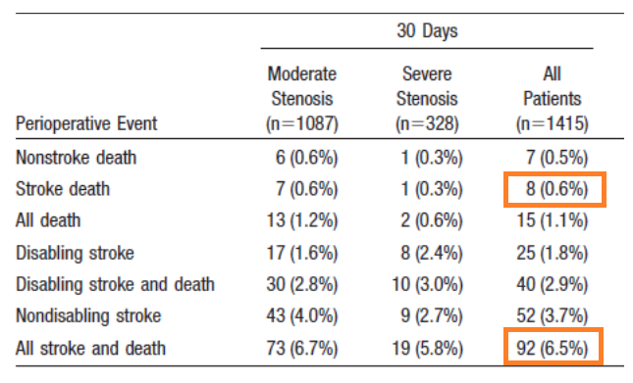
NASCET- Perioperative events
Notes:
Moderate < 70%
Severe 70-90%

Slide 11
Notes:
Severity was categorized as follows: mild complication, no delay in
discharge, recovery documented in follow-up; moderate complication, delay in
discharge, readmission, or documented that deficit never recovered; severe
complication, permanent functional disability, including death

Slide 12
Prospective randomized multi centre trial.
39 clinical sites across US and Canada.
1662 patients with asymptomatic carotid stenosis > 60% randomized to CEA versus medical therapy.
Study was halted at 2.7 years because of a projected 5.9% absolute risk reduction at 5 years favouring CEA ( projected rate for ipsilateral stroke 11% in medical group vs 5.1% in CEA group).
Perioperative stroke rate was 2.3%.
Notes:
By doppler

Slide 13
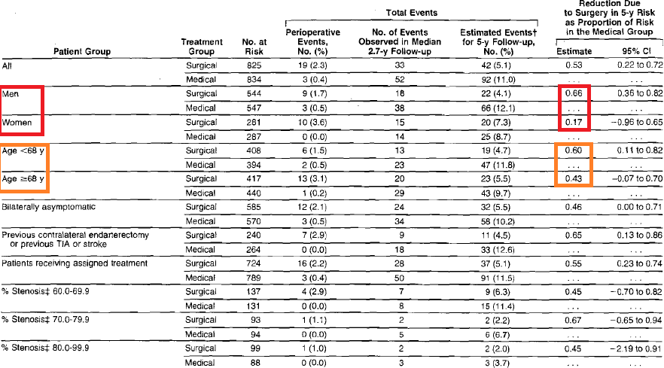
Conclusion: Patients with asymptomatic carotid stenosis > 60% will have reduced 5 year risk of ipsilateral stroke if CEA can be performed with less than 3% perioperative morbidity and mortality
Notes:
Benefit more in men and younger individuals

Slide 14
3120 asymptomatic patients( with > 60% stenosis from 126 centres in 30 countries were allocated equally to immediate CEA or to indefinite deferral of any carotid procedure.
Perioperative risk of stroke or death within 30 days was 3·0% .
Excluding perioperative events and non-stroke mortality, stroke risks (immediate vs deferred CEA) were 4·1% versus 10·0% at 5 years (gain 5·9%, 95% CI 4·0–7·8) and 10·8% versus 16·9% at 10 years (gain 6·1%, 2·7–9·4).
Combining perioperative events and strokes, net risks were 6·9% versus 10·9% at 5 years (gain 4·1%, 2·0–6·2) and 13·4% versus 17·9% at 10 years (gain 4·6%, 1·2–7·9)
Notes:
By Duplex doppler

Slide 15
Successful CEA for asymptomatic patients younger than 75 years of age reduces 10-year stroke risks.
Net benefit in future patients will depend on future surgical risks (which might differ from those in trials) and on whether life expectancy exceeds 10 years.

Slide 16
Notes:
Risk of stroke among medically treated patients was constant over the duration of the study.
Intervention may be approached in a more elective fashion.

Slide 17
The initial case-series and registries of carotid stenting

Slide 18
Global carotid artery stent registry
Update in 2003
12,392 procedures done .
Technical success rate of 98.9%.
TIA rate of 3.07%, minor strokes of 2.14%, major strokes of 1.20%, and procedure-related deaths of 0.64%.
6753 cases done without protection - 5.29% rate of strokes and procedure related deaths.
4221 cases with cerebral protection - 2.23% rate of strokes and procedure-related deaths.

Slide 19
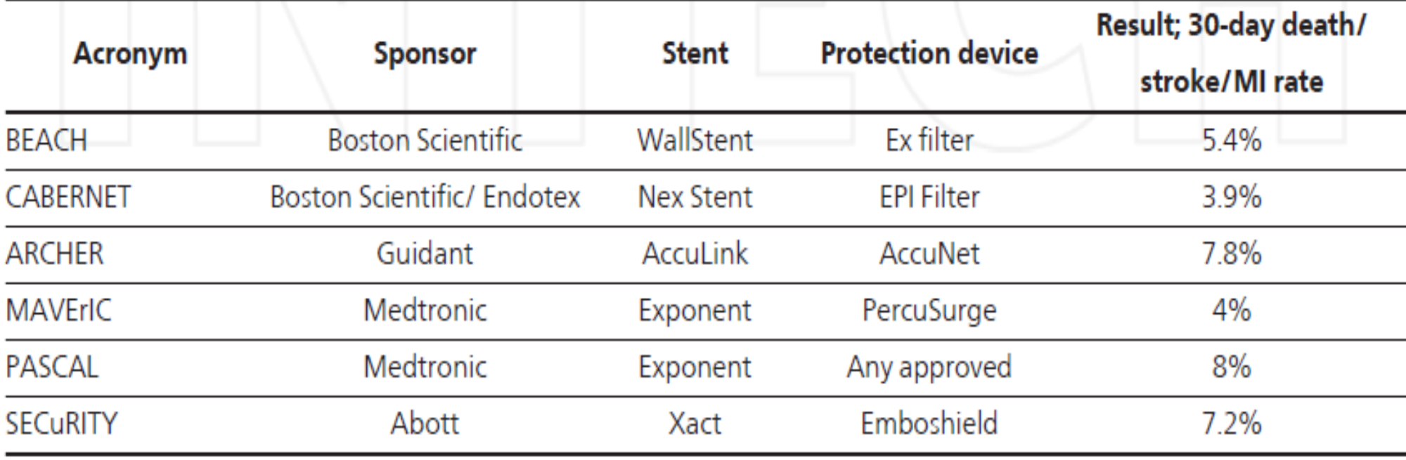
Registries included patients who are considered high risk for CEA :
1. Class-III/IV congestive heart failure
2. Left ventricular ejection fraction<30%
3. Open heart surgery within 6 weeks
4. Recent myocardial infarction (>24 h <30 d)
5. Unstable angina: class III/IV
6. Concurrent requirement for coronary revascularization
7. Severe pulmonary disease
8. Contralateral carotid occlusion
9. Previous radiation to head/neck
10. Previous CEA
11. Age >80 y
12. Surgically inaccessible lesions

Slide 20
RCTs comparing CEA versus CAS
CAVATAS
SAPPHIRE
CARESS
SPACE
EVA-3S
ICSS
CREST

Slide 21
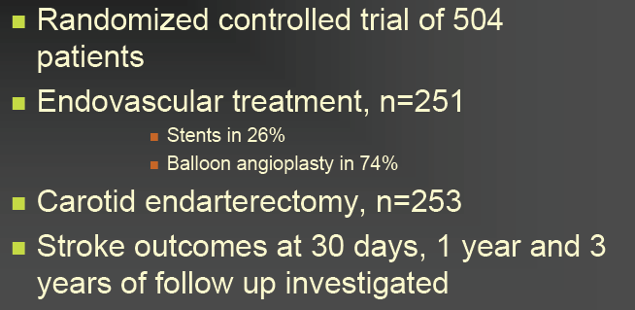
CAVATAS trial
Carotid and Vertebral Artery Transluminal Angioplasty Study
Notes:
Most were symptomatic

Slide 22
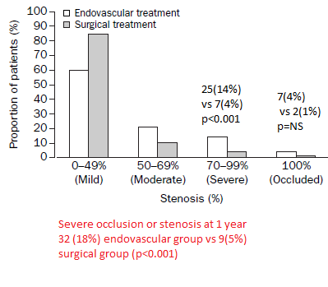
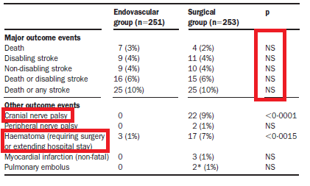
Notes:
At 30 days.

Slide 23
Conclusion: Endovascular treatment had similar major risks and effectiveness at prevention of stroke compared with carotid surgery.
Notes:
At 3 years

Slide 24
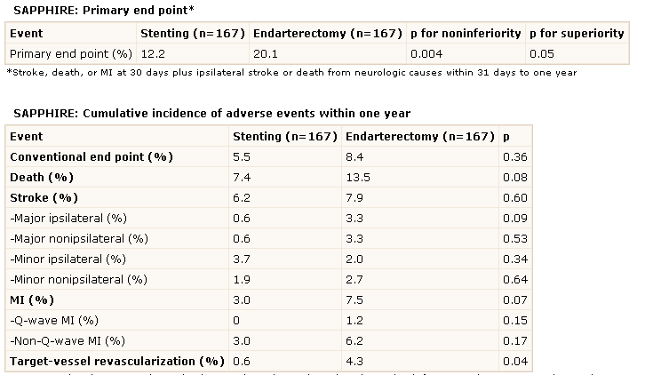
SAPPHIRE trial
Stenting and Angioplasty with Protection in Patients at High Risk for
Endarterectomy
Prospective, randomized, multicenter trial sponsored by Cordis.
Notes:
Rationale was that patients with these co-morbid conditions appear to represent the majority of patients undergoing CEA,
and concerns have been raised about the generalizability of the CEA trial results in view of the
exclusion of those patients in major CEA trials.
All carotid stenting procedures were done with the Angioguard protection device.

Slide 25
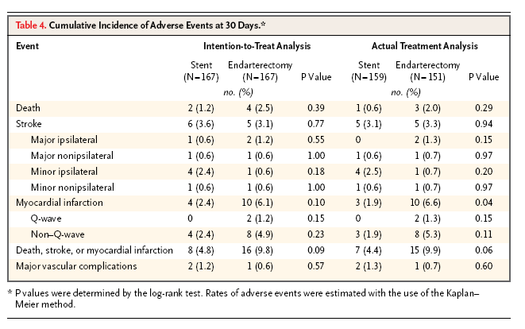

Slide 26
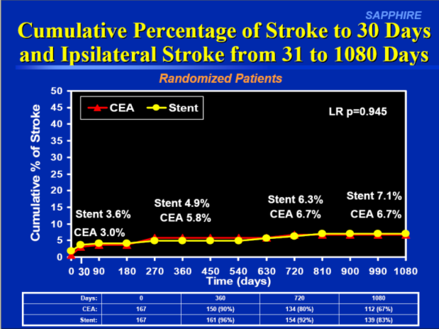
No significant difference between protected carotid artery stenting and carotid endarterectomy with respect to the risk of stroke or other major adverse events in high-risk patients at 3 years.
Patients with asymptomatic carotid disease underrepresented.
Provides no insight into outcomes of treatment of patients at low-to-moderate risk.

Slide 27
CARESS trial
Carotid Revascularization Using Endarterectomy or Stenting Systems
Prospective, multicenter non-randomized industry-sponsored trial.
Patients with symptomatic (>50% stenosis) or asymptomatic (>75% stenosis) carotid stenosis were entered into the study in a 2:1 ratio to CEA vs CAS (with Guardwire plus distal protection device).
A total of 397 patients (with broad surgical risk) (254 CEA and 143 CAS) were enrolled in the study: 32% were symptomatic and 68% were asymptomatic.
Notes:
Guardwire _ distal occlusion device

Slide 28
The CaRESS study suggested that the risk of death or stroke 1 year after CAS by using distal protection is equivalent to that after CEA in a broad-category population with
both symptomatic and asymptomatic carotid stenosis.
Notes:
Following the publication of the SAPPHIRE and the CARESS trials, carotid artery stenting
rocketed.

Slide 29
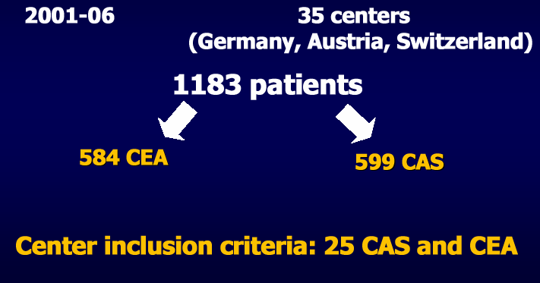
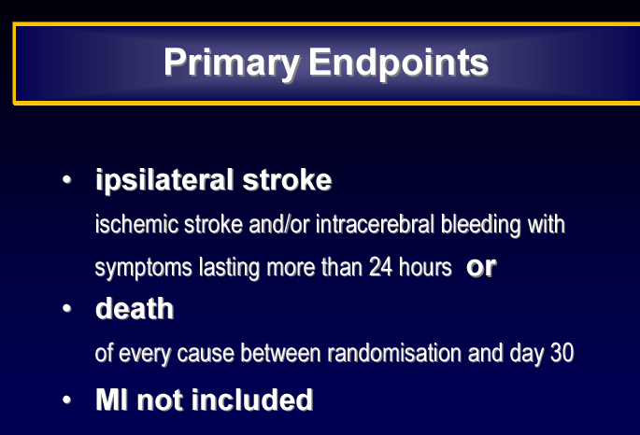
SPACE trial
Stent-protected angioplasty versus carotid endarterectomy trial
30 day results. Randomised non inferiority trial.

Slide 30
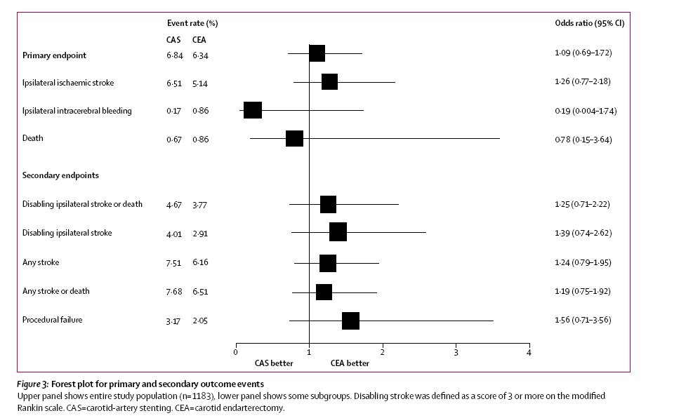
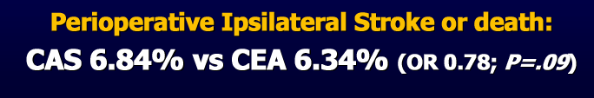

Slide 31
Ipsilateral ischaemic strokes up to 2 years after the procedure and any periprocedural stroke or death did not differ between the CAS and the CEA groups (9·5% vs 8·8%; hazard ratio (HR) 1·10, 95%CI 0·75 to 1·61;p=0·62).
Recurrent stenosis of >70% is more frequent in the CAS group compared with the CEA group with a life-table estimate of 10·7% versus 4·6% (p=0·0009).
Notes:
The rate of recurrent ipsilateral ischaemic strokes reported in the SPACE trial is similar for both treatment groups. The incidence of recurrent carotid stenosis at 2 years, as defined by ultrasound, is significantly higher after carotid artery stenting

Slide 32
Criticisms of SPACE
Recruitment slower than expected.
Abandoned for funding problems after futility analysis ( 1900 pts sample would only yield a 53% power; 2500 needed).
No routine use of EPD ( used only in 27% of cases).
Enrolment in this trial were in the early stages with regards to advancement in CAS device technology and operator experience.

Slide 33
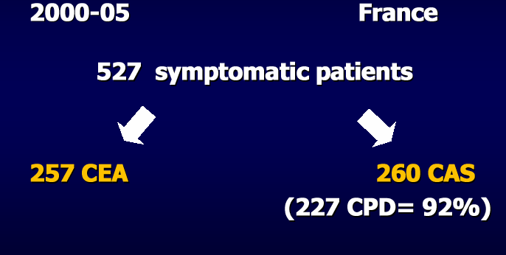
EVA-3S trial
Endarterectomy Versus Angioplasty in Patients with Symptomatic Severe Carotid Stenosis
Multicentre, randomised, open, assessor-blinded, non-inferiority trial.
Funded by French ministry of health.
The cumulative probability of periprocedural stroke or death and non-procedural ipsilateral stroke after 4 years:
CAS 11·1% vs CEA 6·2% p=0·03).
Hazard function analysis showed the differences were predominantly due to increase in postprocedural events.
Notes:
Largely accounted for by the higher periprocedural (within 30 days of the procedure) risk of stenting compared with endarterectomy

Slide 34
Rate of carotid restenosis of ≥50% or occlusion was significantly higher after CAS (12.5%) than after CEA (5.0%)(P=0.02).
Rates of severe restenosis of ≥70% or occlusion were low and did not differ significantly between the 2 groups (3-year rates are 3.3% in the CAS group and 2.8% in the CEA group).
Age was the only subgroup variable which significantly modified the treatment effect:
  In patients <70 years, the 120-day stroke or death risk was 5.8% in CAS and 5.7% in CEA
  In patients >70 years, 12.0% in CAS vs. 5.9% in CEA (p = 0.0053).
  CAS is as effective as CEA for middle-term prevention of ipsilateral stroke but the safety of CAS needs to be improved.
Endarterectomy was safer in the short-term than stenting because of an increased risk of stroke associated with stenting especially in patients over the age of 70 years.
Notes:
Stenting should be avoided in older patients, but may be as safe as endarterectomy in younger patients.

Slide 35
ICSS trial
International Carotid Stenting study
Multicentre international blinded RCT.
1713 patients > 40 years of age and had symptomatic ( symptoms within 12 months) carotid artery stenosis > 50% measured by NASCET criteria.
Funding: Medical Research council, the stroke association, Sanofi-synthelabo, European Union.
Primary outcome: 5 year rate of fatal or disabling stroke in any territory.
Main outcome measure for the interim safety analysis was the 120-day rate of stroke, death or procedural MI.

Slide 36
Carotid stenting is as effective as CEA in preventing fatal or disabling stroke in patients with symptomatic carotid stenosis.
Carotid stenting associated with higher procedure related and long term risk of non disabling stroke than CEA.

Slide 37
CREST trial
Carotid Revascularization Endarterectomy vs. Stent Trial
2522 patients with both symptomatic and asymptomatic carotid artery stenosis to CAS vs CEA.
Symptomatic patients with >50% stenosis by angiography and asymptomatic patients > 70% stenosis.
Funded by Abbott vascular solutions.
Primary composite end point was stroke, MI or death from any cause during the periprocedural period or any ipsilateral stroke within 4 years after randomization

Slide 38
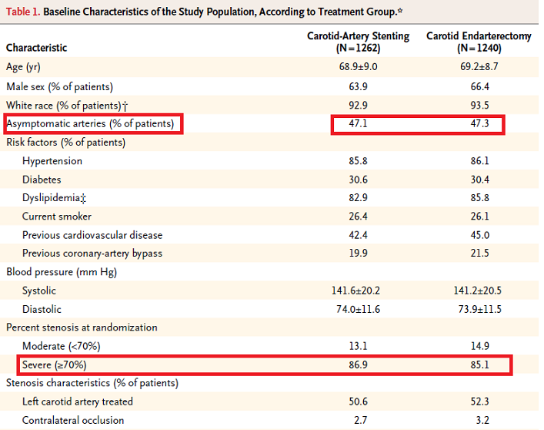

Slide 39
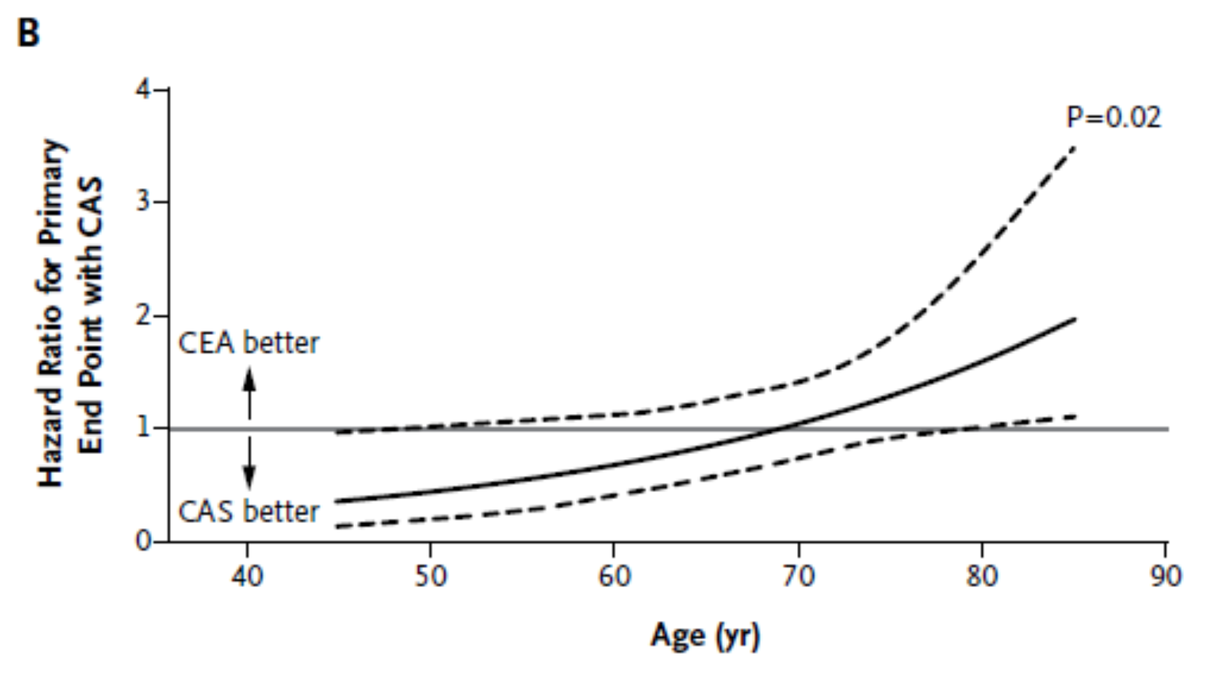
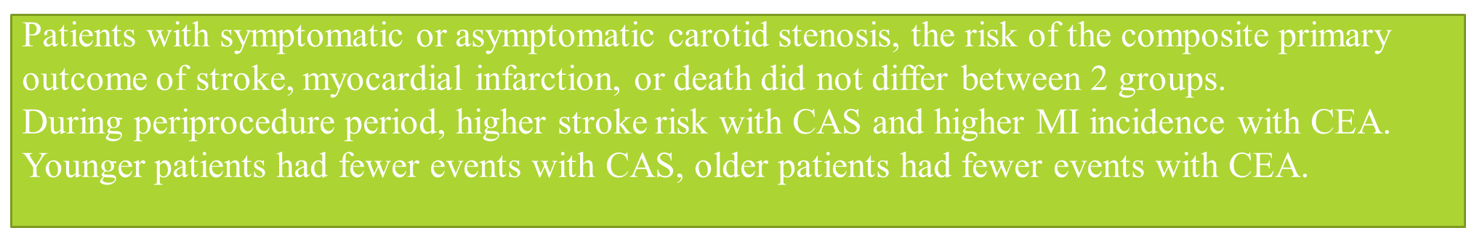

Slide 40
Hemodynamic depression
Defined as hypotension with systolic pressure values < 90 mmHg and bradycardia with heart rate < 60 beats per minute.
Transient pressure from angioplasty and more prolonged pressure from the self expanding stent – activates baroreceptors.
Effects seen mostly at the time of intervention; in some patients may persist for 24 to 48 hrs.
Retrospective analysis of 500 consecutive CAS cases, frequency of periprocedural hemodynamic depression 42% and persistent hemodynamic depression 17%.
Prophylactic measures- withhold antihypertensives on morning of procedure and adequate hydration prior to and during procedure.
Treatment: Intravenous pressors in symptomatic hemodynamic depression or severe asymptomatic hemodynamic depression (SBP<70).
Gupta R et al.Rate, predictors and consequences of hemodynamic depression after carotid artery stenting’J Am Coll Cardiol 47; 1538-43,2006

Slide 41
Hyperperfusion syndrome
Hyperperfusion is defined as the increase in CBF after revascularization compared to preoperative or baseline values.
Most common in patients with CBF increases of more than 100% compared with baseline values.
Mechanisms:
Exhausted vascular reactivity in patients with extracranial stenosis.
  Severity of microvascular autoregulation impairment dependent on duration and intensity of cerebral hypoperfusion.
Postoperatively elevated systemic blood pressure due to baroreceptor reflex failure after receptor denervation during CEA.
Notes:
The main autoregulatory mechanism is the cerebrovascular
reactivity, the ability of the arterioles to constrict or
dilate in response to the alterations of blood flow.
Associated with the grade
of the ipsilateral carotid stenosis, the presence of contralateral
carotid occlusion, and poor collateral flow.

Slide 42
Limitations of available data
The influence of the industry is strong; the industry sponsored registries of CAS had lower rates of complications compared to RCTs.
Levels of expertise of operators vary significantly among trials.
Advances in both medical and interventional strategies emphasizing need for new trials.
  Present optimal medical targets aims at much stricter glycemic and lipid targets.
  Newer devices for emboli prevention and their role.
Improvement in cognitive function after carotid revascularization not considered.
  Cognitive changes should be used as end points in all trials.

Slide 43
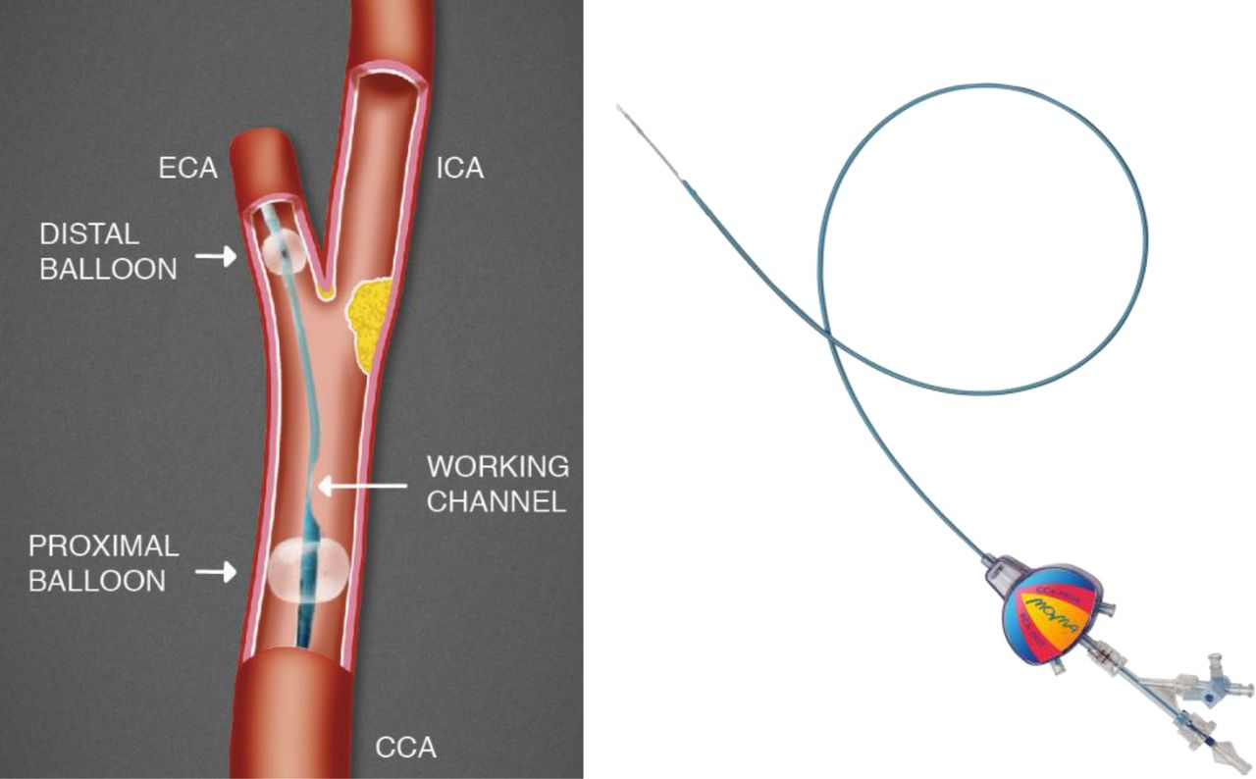
Proximal protection devices
Drawback of filter type distal emboli protection devices
  No cerebral protection is offered till the lesion is crossed with both the wire and the filter device
  When a critical stenosis is present, predilation may be required prior to crossing the lesion and deploying the device
  Clogging of filter; impaired antegrade flow and risk of spillage during device retrieval.
Mo. Ma system (Medtronic)
Gore Flow Reversal system
Notes:
Most CAS trials till date have used distal emboli protection devices.
Mo. Ma system: ECA balloon occlusion of vessels 3 to 6 mm
CCA balloon occlusion of vessels 5 to 13 mm
once both balloons inflated- antegrade blood flow arrested.
through working channel any guidewire and stent may be deployed.
Gore system allows for both active and passive flow reversal.

Slide 44
Trials for Proximal protection devices.
ARMOUR trial: Mo. Ma device in high risk surgical patients.
  222 patients. Patients with > 70% contralateral disease were excluded.
  Device deployment successful in 98.2%.
  30 day stroke rate 0.9%.
EMPIRE trial: Gore Flow Reversal System in high risk surgical patients.
  245 patients. Critical stenosis and even occlusion of the contralateral ICA were not excluded. 10.5% had total contralateral disease.
  Device deployment successful in 99.2%.
  30 day stroke and death rate 2.9%.

Slide 45
2,397 patients from six independent databases.
Primary endpoint was the composite of total stroke, myocardial infarction, and death at 30 days.
The incidence of stroke was 1.71%, MI was 0.02% and death was 0.40%. The composite primary endpoint at 30 days was 2.25%.
Total stroke rates remained below 2.6% in all subgroups
Bersin RM, Stabile E, Ansel GM, et al. A meta-analysis of proximal occlusion device outcomes in carotid artery stenting. Catheter Cardiovasc Interv. 2012;80(7):1072-1078.
Notes:
Head-to-head studies comparing proximal protection device vs distal embolic protection devices were small and used surrogate end points
Success of these devices depends on adequate collateral circulation from the circle of Willis.
Particularly useful in cases where tortuosity and disease distal to carotid bifurcation lesion would preclude use of distal filter and occlusion type devices.

Slide 46
A new set of trials called “Trials 2” are now developing and ongoing
European Carotid Surgery Trial-2 (ECST-2): Patients with symptomatic or asymptomatic moderate or severe carotid stenosis at low or intermediate risk of future stroke. Compares the risks and benefits of treatment by modern OMT alone versus the addition of immediate carotid surgery (or stenting) to OMT.
Asymptomatic Carotid Surgery Trial-2 (ACST-2): Compares CEA with CAS in the prevention of stroke in patients with asymptomatic carotid stenosis.
Stent-protected angioplasty in asymptomatic carotid artery stenosis vs. endarterectomy Trial-2 (SPACE-2): Patients with asymptomatic stenosis between CAS vs. CEA vs. OMT only.
Carotid Revascularization Endarterectomy versus Stenting Trial-2(CREST-2): Revascularization vs. contemporary medical management alone.

Slide 47
Specific conditions
Restenosis after carotid angioplasty
Restenosis rate low 2.3% - 10%.
  Self expanding carotid stents generate considerable neointimal hyperplasia.
  Process balanced by marked late stent enlargement.
2003 Global Carotid Stent Registry data:
12,392 procedures involving 11,243 patients
Restenosis rates 2.7%, 2.6%, and 2.4% at 1, 2, and 3 years respectively.

Slide 48
Retrospective, single-center review conducted of 399 carotid stent procedures in 363 patients over 9 years.
Mean follow-up of 24 months (range 6-99 months).
Restenosis occurred in 15 patients (3.8%).
  7 of 35 (20%) patients who had previous neck radiation
  6 of 57 (10.5%) patients who had previous CEA
  2 of 9 (22%) patients who previously had both CEA and neck radiation.
Variables associated with an increased risk of restenosis
  Previous CEA (OR 4.28, P = 0.008)
  XRT (OR 11.3, P= 0.0001)
Younis, G.A., et al., Predictors of carotid stent restenosis. Catheter Cardiovasc Interv,2007

Slide 49
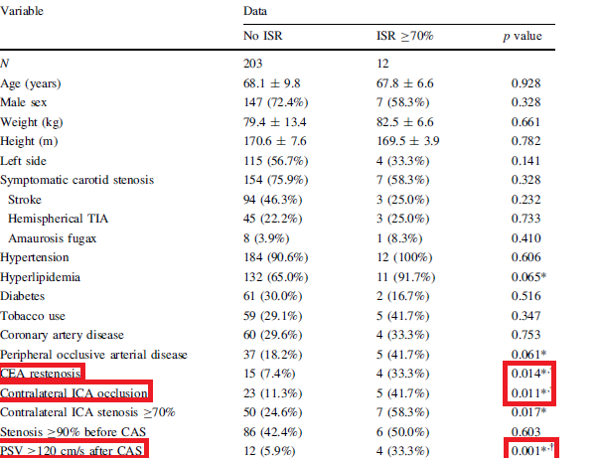
Analyzed 215 CAS procedures that had clinical and serial carotid duplex ultrasound investigations.
Most restenoses occur within 6 to 12 months after the intervention.
Associated with a higher risk of clinical complications
Usually they are located either in the mid or at the distal end of the stent
Wasser, K., et al., Clinical impact and predictors of carotid artery in-stent restenosis. J Neurol, 2012. 259(9)
Notes:
Contralateral stenosis and CEA restenosis are 2 groups wherein CAS is preferred for revascularization and they are associated with increased risk of ISR.
Peak systolic velocity

Slide 50
Restenosis after carotid endarterectomy
Incidence ranges from 1.2% to 23.9%.
Highest rates of restenosis after CEA came with direct suture and the lowest rates were after patch angioplasty only.
Risk is highest in the first few years after CEA and is very low later.
Raithel, D., Recurrent carotid disease: optimum technique for redo surgery. J Endovasc Surg, 1996. 3(1): p. 69-75.
Most of restenoses are asymptomatic and only 1.2-3.6% require re-intervention.
Frericks, H., et al., Carotid recurrent stenosis and risk of ipsilateral stroke: a systematic review of the literature. Stroke, 1998. 29(1): p. 244-50.
Myointimal hyperplasia has a smooth luminal surface - low potential for embolization - simple patching.
Recurrent atherosclerosis – greater potential for embolization - repeat CEA with carotid patch angioplasty.

Slide 51
Compared early and late results of 124 reoperations with 265 primary CEAs over a 7 year period.
30 day perioperative stroke and TIA rates for reoperation and primary CEA were 4.8% vs 0.8% (P=0.015) and 4% vs 1.1% respectively.
Cranial nerve injuries were noted in 17% vs 5.3%.
Cumulative rates of stroke-free survival and freedom from 50% recurrent stenosis for reoperation and primary CEA at 1, 3, and 5 years were similar among the 2 groups.
Notes:
? CAS better option.

Slide 52
Carotid disease in CABG population
Prevalence of severe carotid disease (> 70%) in those with triple vessel or LMCA disease – 7-11%.
Prevalence as well as severity of carotid stenosis shows a stepwise correlation with the extent of coronary disease.
Bilateral carotid artery disease – < 3% of CABG population.
Review by Naylor et al., the peri-CABG stroke risks were 3% with asymptomatic unilateral 50–99% carotid stenosis, 5% with bilateral 50–99% carotid stenosis and 7-11% with carotid occlusion respectively.
Naylor AR, Mehta Z, Rothwell PM, Bell PR. Carotid artery disease and stroke during coronary artery bypass: a critical review of the literature. Eur J Vasc Endovasc Surg 2002; 23:283–294.
Single center study with 4335 cardiac surgery patients - 7.5% risk of perioperative stroke with significant carotid stenosis vs 1.8% for the entire cohort (P=0.001)
Li Y, Walicki D, Mathiesen C, etal. Strokes after cardiac surgery and relationship to carotid stenosis. Arch Neurol 2009; 66:1091–1096
Notes:
Although extracranial carotid stenosis greater than 50–60% is an established risk factor
for stroke in general, in the peri-CABG setting, 60–80% of strokes in patients with significant carotid
stenosis occur in the territory not perfused by the affected carotid.
50–75% of perioperative strokes overall occur in the absence of significant carotid stenosis
Aortic arch embolisation may be an important cause of stroke

Slide 53
Approaches:
Staged
Combined
Reverse Staged
Patients who undergo combined CEA-CABG procedures are more likely to have critical disease in both territories.
No significant overall difference in 30-day death, MI, or stroke risk for staged and combined procedures, with the risk being 10–12%.
Naylor AR, Cuffe RL, Rothwell PM, Bell PR. A systematic review of outcomes following staged and synchronous carotid endarterectomy and coronary artery bypass. Eur J Vasc Endovasc Surg 2003; 25:380–389.
No increased risk with the addition of CEA to CABG.
Ricotta JJ, Wall LP, Blackstone E. The influence of concurrent carotid endarterectomy on coronary bypass: a case-controlled study. J Vasc Surg 2005; 41:397–401.
Combined CEA-CABG was associated with a significantly higher neurological complication rate (6.8%), operative mortality (4.1%), and length of stay in comparison to those with untreated stenosis > 75%.
Prasad SM, Li S, Rankin JS, et al. Current outcomes of simultaneous carotid endarterectomy and coronary artery bypass graft surgery in North America. World J Surg 2010; 34:2292–2298.

Slide 56
2011 ACC/AHA guidelines for Coronary Artery Bypass Graft Surgery
Class IIA: In the CABG patient with a previous TIA or stroke and a significant (50% to 99%) carotid artery stenosis, it is reasonable to consider carotid revascularization in conjunction with CABG(LOE: C).
Class IIB: In the patient scheduled to undergo CABG who has no history of TIA or stroke, carotid revascularization may be considered in the presence of bilateral severe (70% to 99%) carotid stenoses or a unilateral severe carotid stenosis with a contralateral occlusion(LOE: C).

Slide 57
CEA in presence of contralateral occlusion
Higher surgical risk for CEA:
  Reduced collateral circulation during carotid clamping
  Cerebral hemorrhage secondary to hyperperfusion syndrome
  Overall advanced status of the vascular disease.
34% of the surgically treated patients were alive at 66 months in contrast to 63% of medically treated patients.
Medically treated patients with contralateral occluded carotid twice as likely to have a stroke than those with a patent artery - NASCET.
Risk of stroke in medically treated patients was 69% at 2 years versus 22% in patients treated surgically.
Blaisdell, W.F., et al., Joint study of extracranial arterial occlusion. IV. A review of surgical considerations. JAMA, 1969. 209(12): p. 1889-95.
Notes:
CEA with contralateral occlusion is a risky procedure but its risk may be justified considering the natural
history of the disease.? CAS

Slide 58
ASA/ACCF/AHA/AANN/AANS/ACR/CNS/SAIP/SCAI/SIR/SNIS/SVM/SVS
2011 Guideline on the Management of Patients With Extracranial Carotid and Vertebral Artery Disease
Notes:
Nondisabling stroke is defined by a residual deficit associated
with a score ≤2 according to the Modified Rankin Scale.
The degree of stenosis is based on catheter-based or
noninvasive vascular imaging compared with the distal
arterial lumen or velocity measurements by duplex
ultrasonography

Slide 59
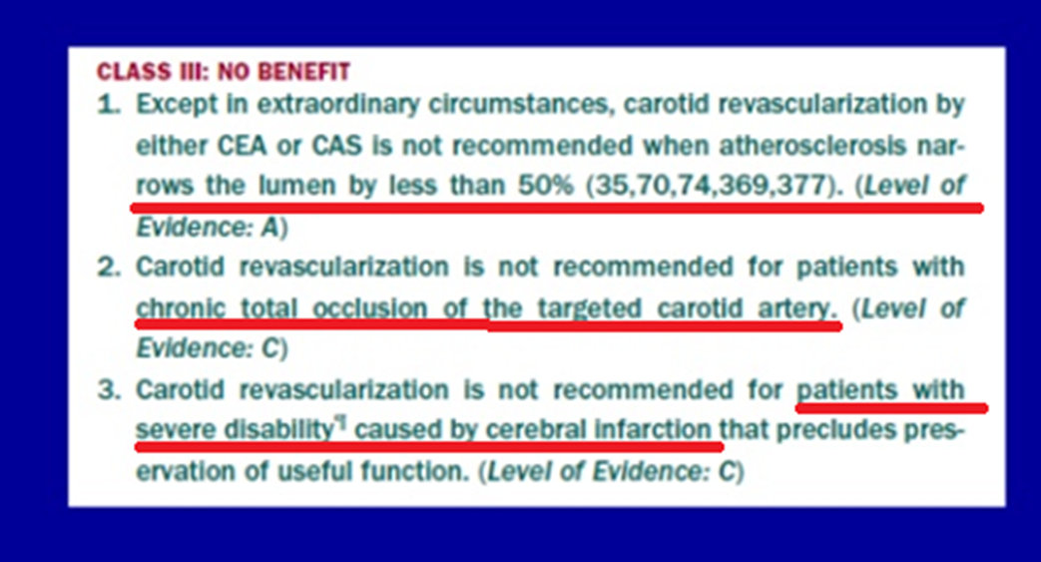

Slide 61
Notes:
European society of vascular surgery 2009

Slide 62
Paradigm Shift
3% RULE
 | RISK FACTOR | FEATURES
CLINICAL | Advanced age | >80 yrs
 | Decreased Cerebral reserve | Dementia Multiple lacunar infarcts Intracranial microangiopathy
ANGIOGRAPHIC | Excessive Tortuosity | 2 or more 90 degree bends 5 cm of the lesion
 | Heavy Calcification | Concentric circumferential calcification width >3mm
Notes:
Conventional vs new paradigm

Slide 63
Summary
CEA has a lower stroke rate than CAS but CAS has a lower MI rate than CEA.
If mortality, stroke and MI are mingled together as a single end-point, then both strategies are equivalent on the long-term.
Advanced age is strongly against selecting CAS as the initial choice of revascularization.
Results of either technique are critically dependent on the skills of the performing physician.
Restenosis after CAS slightly more than restenosis after CEA but the severe, clinically significant restenosis is uncommon.

Slide 64
THANK YOU

